Slide 1

Viscous Liquid Droplet Impact on Microstructured Surfaces
Team 4: Rosemary Barrass, Nikita Kurilenko, Andrew Tunison, and Zachariah Weber
Sponsor: Dr. Hua Tan, WSU Vancouver

Slide 2
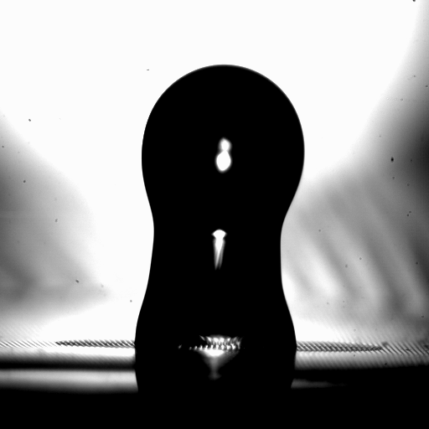
Introduction
Dr. Tan’s current graduate students use MATLAB to process high speed droplet impact videos
Each student must learn the image processing algorithms for their thesis work
Dr. Tan needed a user-friendly Graphical User Interface (GUI) which would use a video input to produce:
Boundary layer images
Droplet velocity
Max spread radius
Contact angle
Droplet formation
Jet speed
Jet formation
Dr. Tan wanted to generate equations and CFD models
Due to time constraints, this was foregone for a user manual to accompany the applet

Slide 3
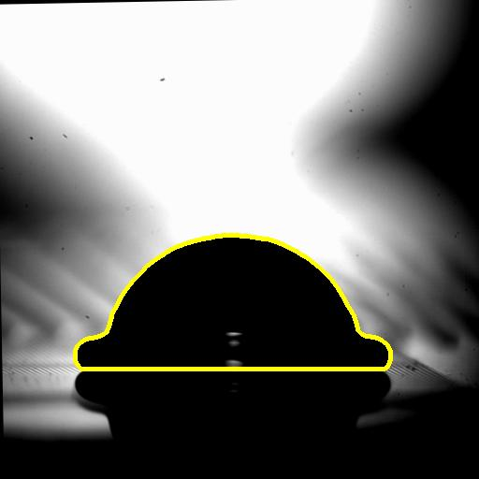
Key Terms
GUI – Graphical User Interface
Applet – A small application for performing one or a few simple functions
CFD – Computational Fluid Dynamics
Spread Radius – The contact radius of a droplet
Callback – A function that is activated by user input

Slide 4
Background Research
Microfluidics research is often very specialized, so there were few tools to compare against for this specific application
GUI Research:
“High Throughput Analysis of Liquid Droplet Impacts” by Matheu A.J. Broom and Geoff R. Willmott¹
MATLAB Documentation
OPTIMAS and ImageJ software^{3,4,6,7,8}
User Manual:
IEEE Standard 1063-2001²
Challenges:
Limited time
Limited programming and microfluidics experience on the team
COVID social distancing

Slide 5
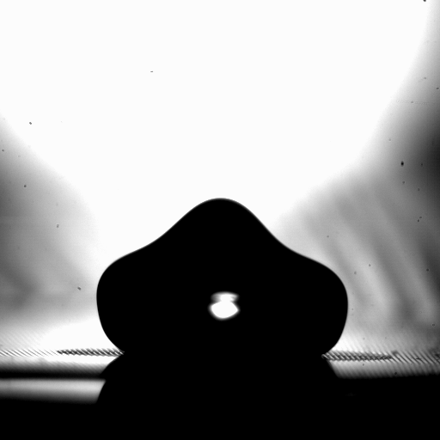
Scope
Project was divided into two main parts:
GUI creation for processing raw video files
Equation generation and CFD simulation of droplet impact based on data collected from GUI
This was replaced with a user manual
The GUI works well for videos in which droplet movement can be estimated in 2-D
GUI was completed using pre-existing MATLAB image processing tools
New functions were created for finding feature data
User manual contains comprehensive instructions for installing and using the GUI
User manual outlines the purpose, functionality, and fault isolation for each system function

Slide 6
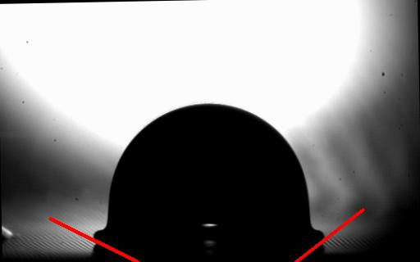
Objectives
GUI to be completed by early Spring semester 2021
Equation generation and CFD modeling to be completed by end of Spring semester 2021
Replaced with user manual to be completed by end of Spring semester 2021
For the GUI:
Produces a .txt file
Outputs:
Fall velocity
Radial velocity
Max spread radius
Contact angle
Jet speed
Jet formation
Droplet formation
For the user manual:
Comprehensive
Meets IEEE software user documentation standards

Slide 7
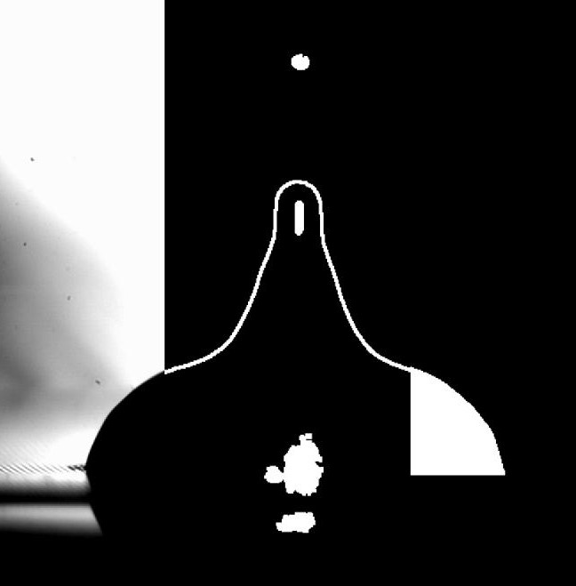
Methods of Approach
Application
Image processing software
GUI development
Merge/ debug
Testing
User Manual
Follow comprehensive standards outlined by IEEE

Slide 8
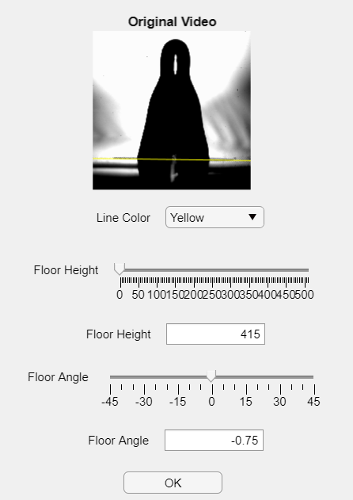
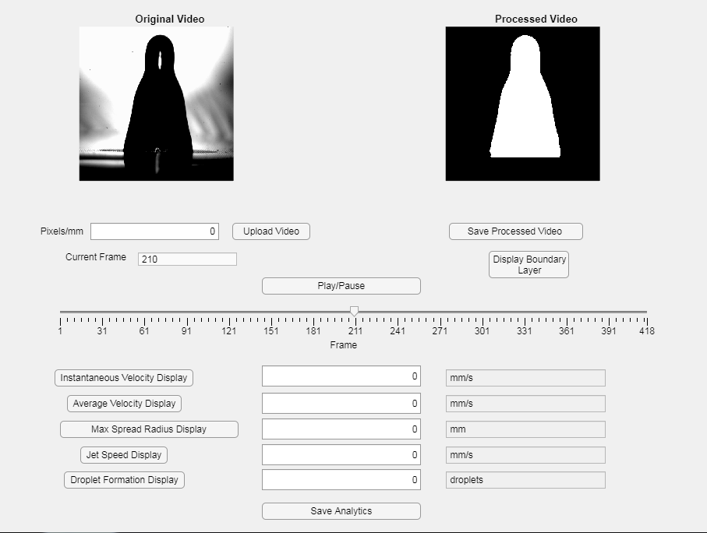
Preliminary Results
GUI Input Parameters:
Video Upload
Floor Height
Floor Angle
GUI Outputs/Features:
Processed images showing droplet boundary
Slider to view all frames
Save processed video
Saves each processed frame into designated folder
Save Analytics
Saves placeholder data as a table to a .csv file
Display of various output parameters

Slide 9
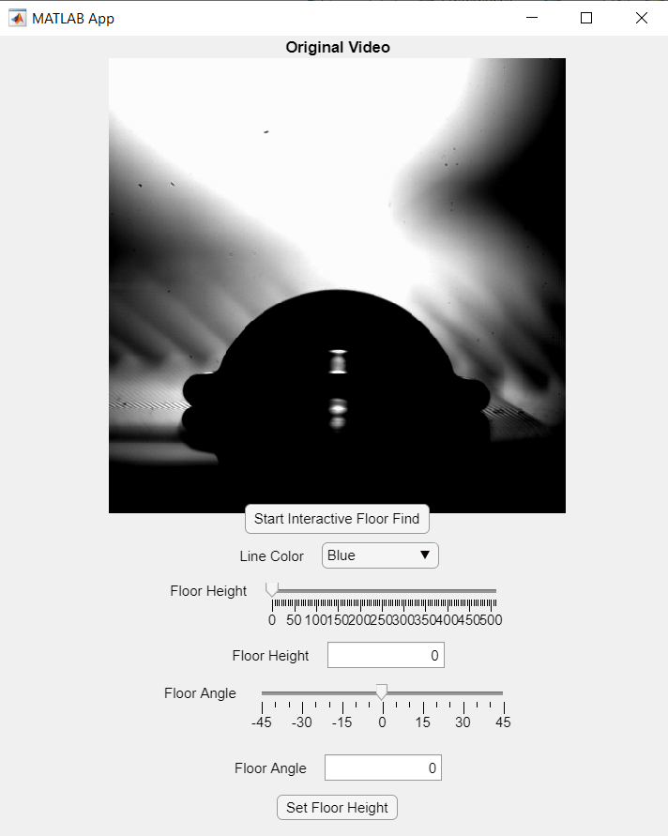
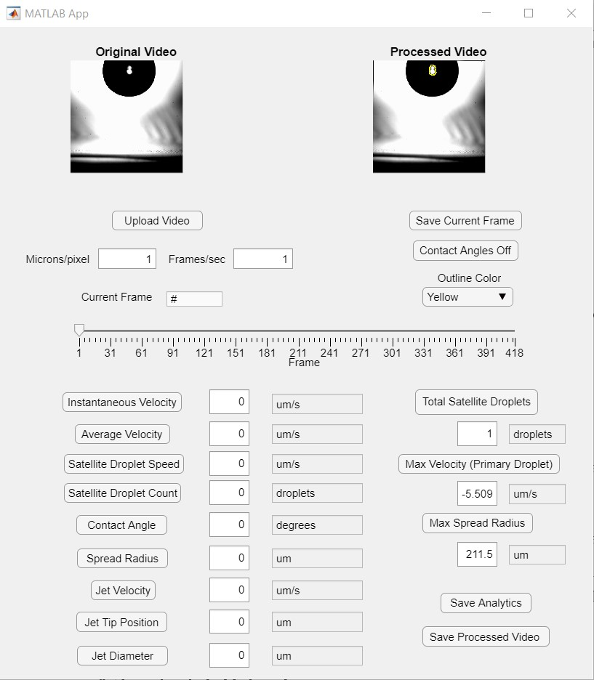
Final Results
GUI Input Parameters:
Video Upload
Floor Height
Floor Angle
Unit conversions
Change from pixels/frame to Microns/Second
GUI Outputs/Features:
Processed images showing droplet boundary or contact angles
Four outline colors
Optimized: Decreased postprocessing time by 75%
Slider to view all frames
Save current frame
Saves current processed frame as an image into a designated folder
Save processed video
Saves processed video as a .AVI into a designated folder
Save Analytics
Saves processed data as a table to a .csv file
Display of various output parameters
Output parameter unit conversions

Slide 10
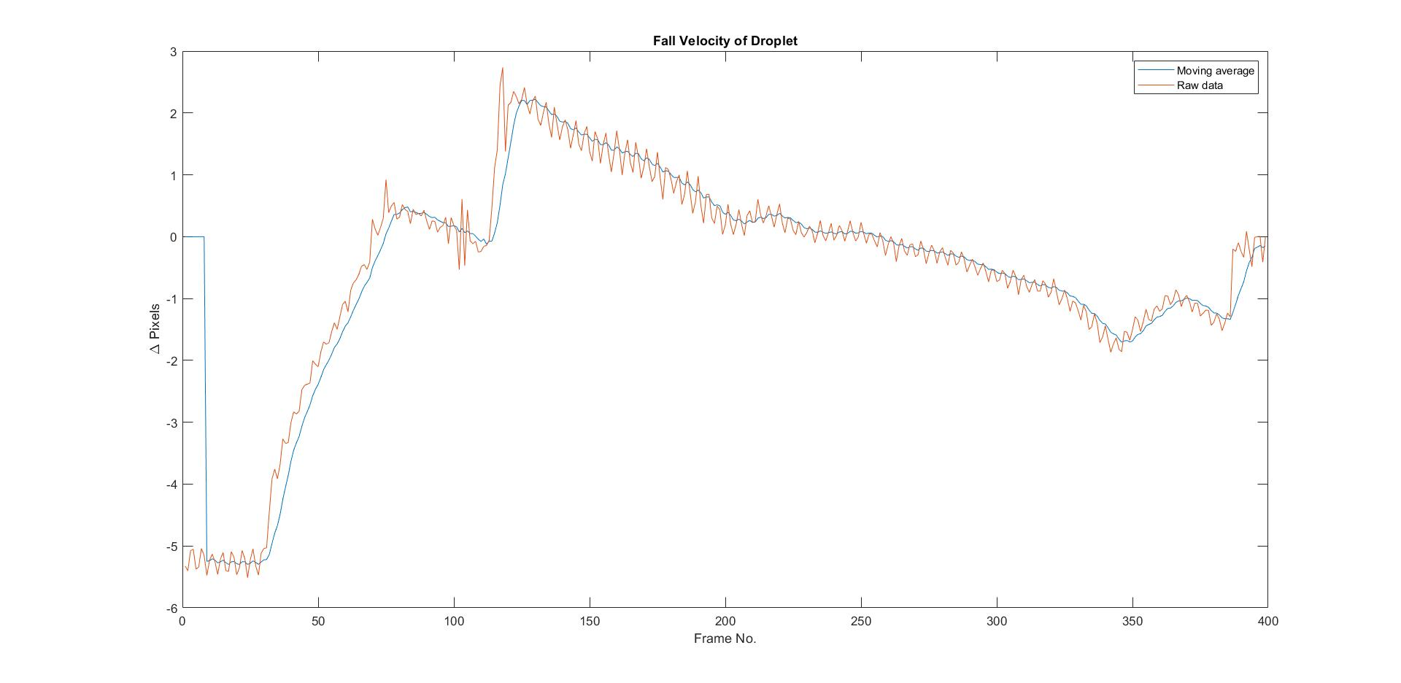
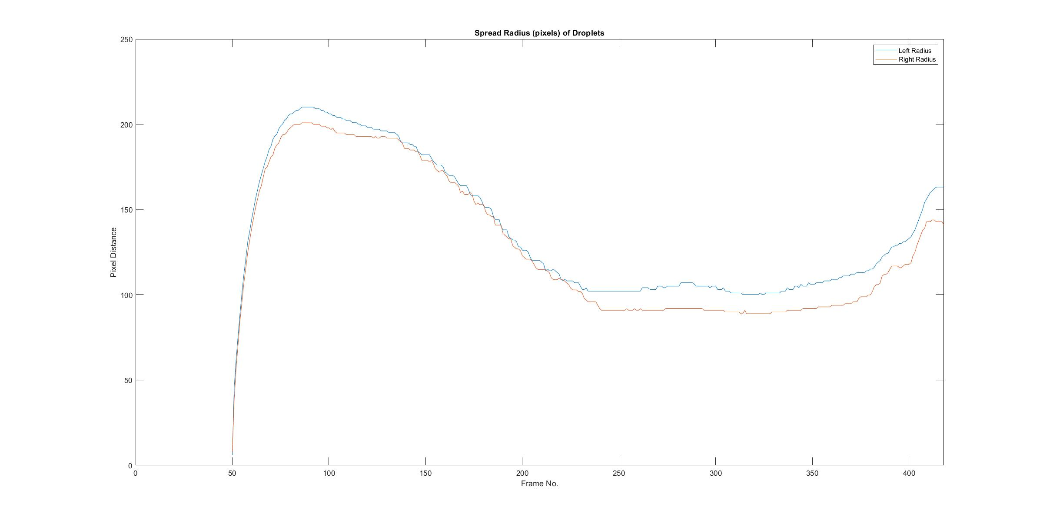
Final Results

Slide 11
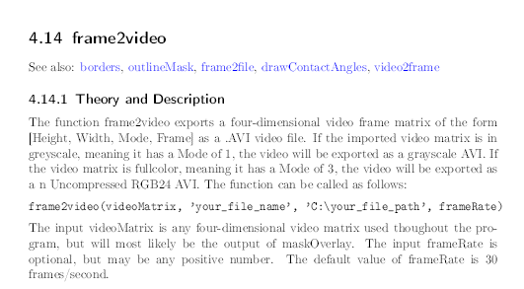
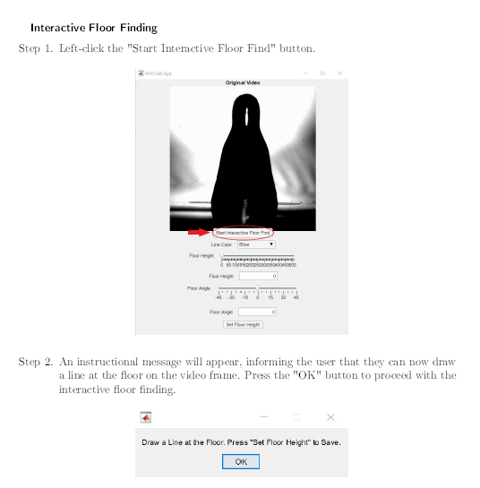
Final Results
User Manual
Introduction includes
Purpose
Conventions
Audience
Scope
Description includes
Perspective
Function
User classes and characteristics
Operating environment
Constraints
Assumptions and dependencies
GUI User Guide includes
Installation
Opening the applet
Using the applet
System Functions includes
Theory and Description for each function
Fault Isolation for each function
Links to related functions
Example of System Function Section
Example of GUI User Guide Section

Slide 12
Sample Processed Videos
Bug: “Flickering” Contact Angles
Contact Angle Video
Boundary Line Video
Bug: Satellite Droplet Not Tracked

Slide 13
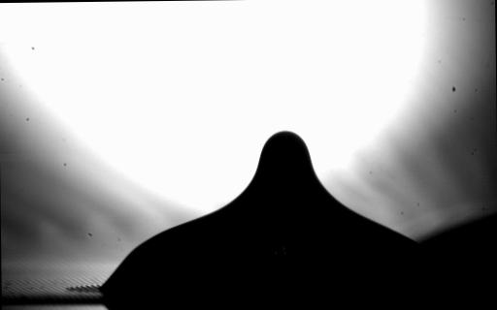
Conclusion
Applet limitations and bugs:
Errors in object tracking
Floor finding, leading to impact data and contact angle error
Noise from reflections and major shadows
Applet created by our group:
Can calculate velocities, contact angles, jet diameter, maximum spread radius, and velocity
Can count satellite droplets
Competing applets main difference:
Can calculate Weber and Reynolds number, impact velocity, and droplet volume
Bug: Major shadow eliminates border

Slide 14
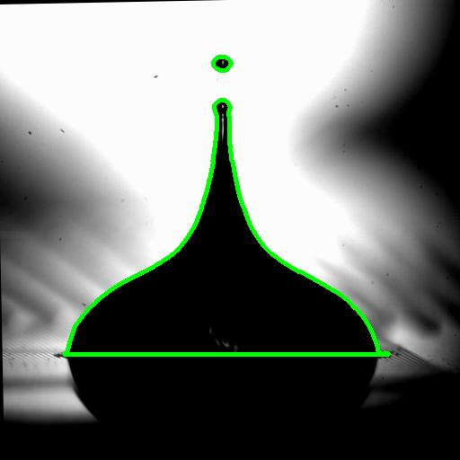
Conclusion
Skills gained in:
MATLAB
Image processing
GUI design
GitHub
LaTeX
To achieve equation generation and CFD simulations, the group could have simplified:
Number of output parameters
GUI capabilities

Slide 15
Recommendations
Next Steps for the Applet:
Finish and integrate automated floor finding
Add a system to identify and keep track of unique objects even when they go off screen
Add additional image processing settings and algorithms for robustness
Continue to add error catching systems
Reduce reliance on user input

Slide 16
Acknowledgements
We would like to thank Dr. Tan for the incredible opportunity to take on this project. Dr. Tan provided our team with great resources and assisted us every step of the way to develop this applet.
We would also like to thank Dr. Kim for providing meaningful and constructive feedback on all our documents. Dr. Kim has helped us create professional documents that will prepare us for major industry projects in the future.

Slide 17
Citations
[1] Broom, Matheu, and Geoff Willmont. “High Throughput Analysis of Liquid Droplet Impact.” Jove Journal, March 6, 2020. https://www.jove.com/t/60778/high-throughput-analysis-of-liquid-droplet-impacts. Accessed October 13, 2020.
[2] IEEE Computer Society. “IEEE Standard for Software User Documentation.” IEEE Std 1063-1987 , New York, Ny. December 20, 2001. https://ncihub.org/files/MTRjZGIzZDF kMzI4NjdhNjg4ZDFjM2E4OGFiYzIyMDMxM2VkYWMzMTk3OThiODFkYTUwNT IwNTEwNTQwMzU1MjovdmFyL3d3dy9uY2lwaHViL2FwcC9zaXRlL2NvbGxlY3R pb25zLzExMzIvSUVFRV9TdGFuZGFyZDEwNjMucGRm
[3] “ImageJ Software.” smalldropsprays.info. Accessed October 22, 2020. http://www.smalldropsprays.info/stepbystepmethods/ImageJ-software.
[4] “Optimas Software for Imaging”, Adept Turnkey, accessed October 21, 2020, http://www.adept.net.au/software/mediacy/optimas/index.shtml

Slide 18
Citations
[5] Siddique, Anayet Ullah Siddique, Marcus Trimble, Feng Zhao, Mark M. Weislogel, and Hua Tan. “Jet ejection following drop impact on micropillared hydrophilic substrates.” APS physics Journals.aps.org, July 15, 2020.
[6] Stalder, A.f., G. Kulik, D. Sage, L. Barbieri, and P. Hoffmann. “A Snake-Based Approach to Accurate Determination of Both Contact Points and Contact Angles.” Colloids and Surfaces A: Physicochemical and Engineering Aspects 286, no. 1-3 (2006): 92–103. https://doi.org/10.1016/j.colsurfa.2006.03.008.
[7] Stalder, Aurélien. “Flevet.” BIII. Accessed October 22, 2020. https://www.biii.eu/lbadsa.
[8] Stalder, A.f., G. Kulik, D. Sage, L. Barbieri, and P. Hoffmann. “A Snake-Based Approach to Accurate Determination of Both Contact Points and Contact Angles.” Colloids and Surfaces A: Physicochemical and Engineering Aspects 286, no. 1-3 (2006): 92–103. https://doi.org/10.1016/j.colsurfa.2006.03.008.

Slide 19
Questions?

